Slide 1
Idea and Project Approach Details Ministry/ Organization name: Bureau of Police Research and Development Problem Statement : Proxy and VPN Detector(RK311) Team Name : The Captivators Team Leader Name : Fardeen Ahmed College Code : U-0923

Slide 2
Idea/Approach Detail
The project focuses on detection of Virtual-IP’s or V-IP’s provided by VPN provider as well as proxies used by user for hiding there physical IP in a network in most convenient manner. The convenience focuses on both ease of use of project as well as faster detection and judgement on real IP’s vs V-IP’s. The project also lays on the idea of geo-location of that IP.
Technology/Tools Used
Below are the Tools used for the project
IDE’s used : Visual Studio Professional 2019, GUI tool for Mongo DB
Text Editor : Sublime Text
Database : Postgresql, MySQL
Languages : Python (Tkinter Library For GUI)

Slide 3
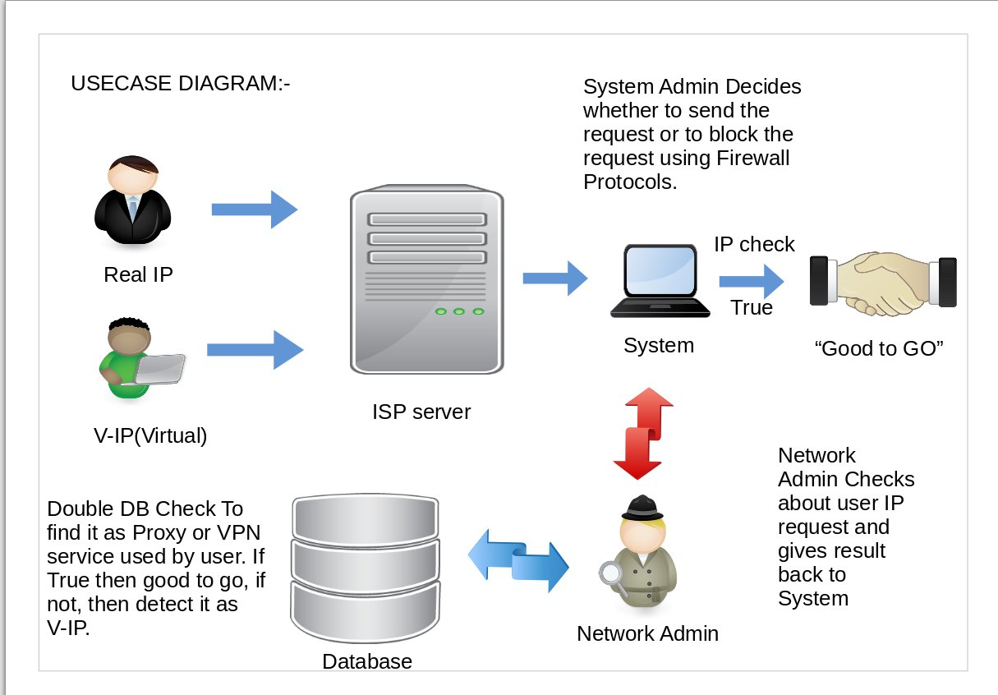

Slide 4
The Project’s Showstopper:-
1) Detection of VPN Service Provider.
2) Sending Request TO VPN Provider for Legal/Illegal use of service provided.

